Slide 1

5.8.2
Pattern Classification
All materials in these slides were taken from
Pattern Classification (2nd ed) by R. O. Duda, P. E. Hart and D. G. Stork, John Wiley & Sons, 2000
with the permission of the authors and the publisher

Slide 2
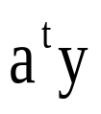

5.8.2 Relation to Fisher’s Linear Discriminant
With the proper choice of the vector b, the MSE discriminant function is directly related to Fisher’s linear discriminant (Chapter 3 Section 3.8.2).
To do so, we use the linear rather than generalized linear discriminant function.

Slide 3
Assumption
A set of n d-dimensional samples x₁,…x_{n}, n₁ of which are in the subset D₁ labeled w₁, and n₂ of which are in the subset D₂ labeled w₂.
A sample y_{i} if formed from x_{i} by adding a threshold component x₀=1 to make an augmented pattern vector.
If the sample is labeled w₂, then the entire pattern vector is multiplied by -1
With no loss in generality, assume the first n₁ samples are labeled w₁ and the second n₂ are labeled w₂.

Slide 4
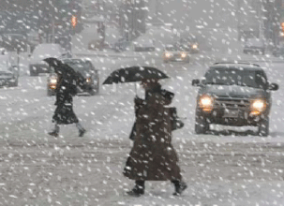
MSE method based on Ya=b can be equivalent to Fisher’s Linear Discriminant
Condition: the number of the samples approaches to infinity.

Slide 5
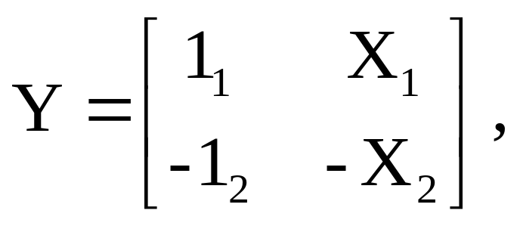
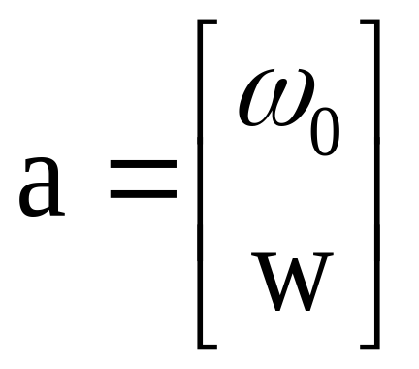
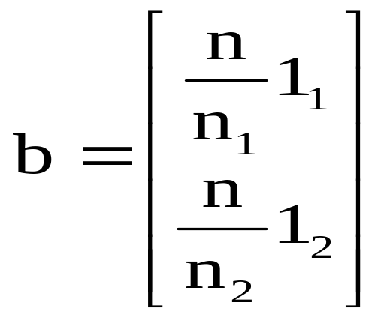

Then the matrix Y can be partitioned as follows:
Where 1_{i} is a column vector of n_{i} ones, and X_{i} is an n_{i}-by-d matrix whose rows are the samples labeled w_{i}.
Correspondingly,

Slide 6
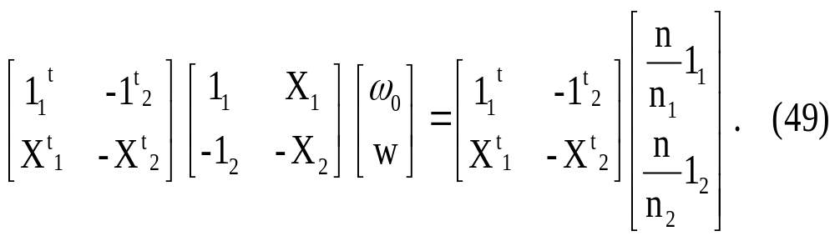
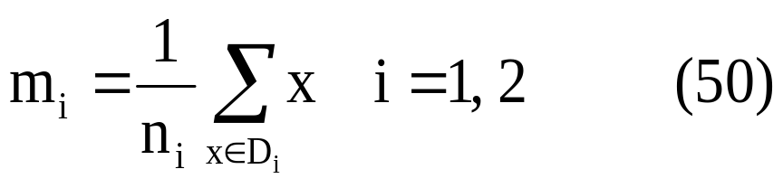
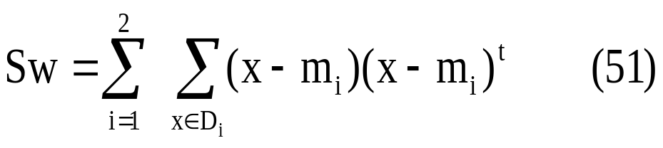
By Writing Eq.45 for a in terms of the partitioned matrices:
Defining the sample means
And the pooled sample scatter matrix

Slide 7
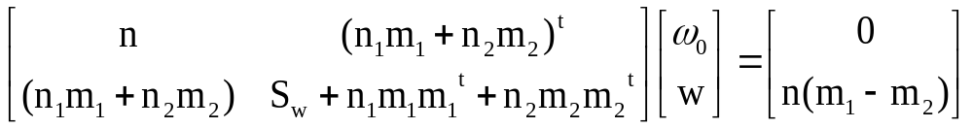
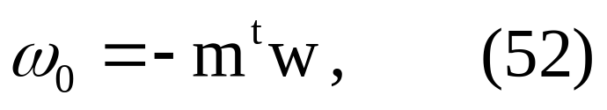
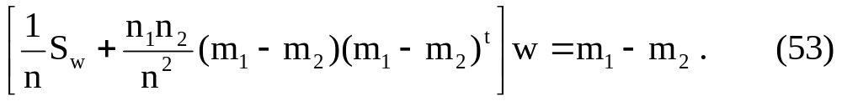
Multiply the matrices of Eq.49 and obtain
This can be viewed as a pair of equations, the first of which can be solved for w₀ in terms of w:
Where m is the mean of all of the samples.
Substituting this in the second equation, we obtain

Slide 8
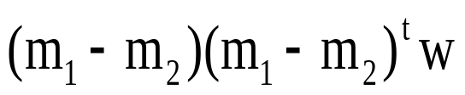

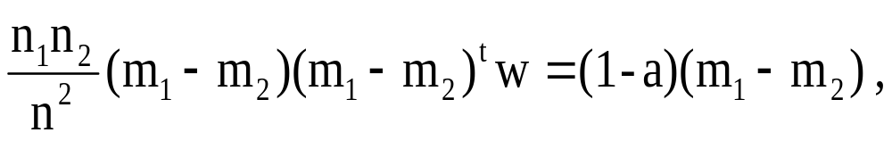
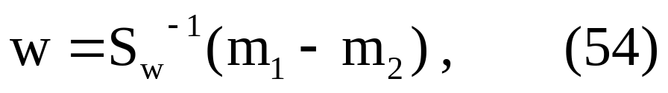
Because the vector is in the direction of
for any value of w, we can write
where a is some scalar.
Then Eq.53 yields
Which, except for an unimportant scale factor, is identical to the solution for Fisher’s linear discriminant.
In addition, we obtain the threshold weight w₀ and the following decision rule:

Slide 9
References of LDA
David Zhang, FengXi Song, Yong Xu, ZhiZhen Liang
"Advanced Pattern Recognition Technologies with Applications
to Biometrics", Medical Information Science Reference, 2009
Yong Xu, David Zhang, Represent and fuse bimodal biometric images at the feature level: complex-matrix-based fusion scheme, Opt. Eng. 49(3), 037002, 2010
Yong Xu, Jing-Yu Yang, Zhong Jin, A novel method for Fisher discriminant Analysis. Pattern Recognition, 37 (2), 381-384, 2004

